Slide 1
Topic: Congruency Eq: How do we know triangles are the same?
Year 9

Slide 2
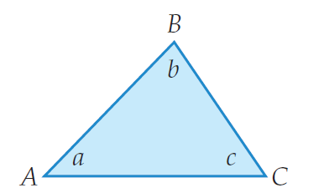
5 questions
Complete last lessons summary.
Name angle C.
What is an acute angled triangle?
Find the missing side of the following triangle:
How big are the angles in an equilateral triangle?
x
7 cm
Topic: Congruency Eq: How do we know triangles are the same?
9.5 cm

Slide 3
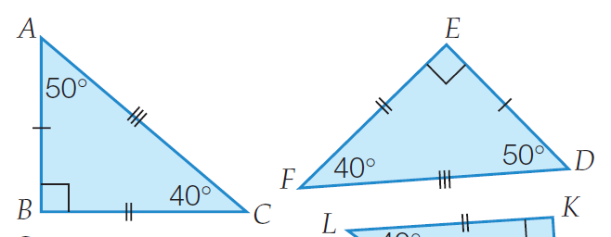
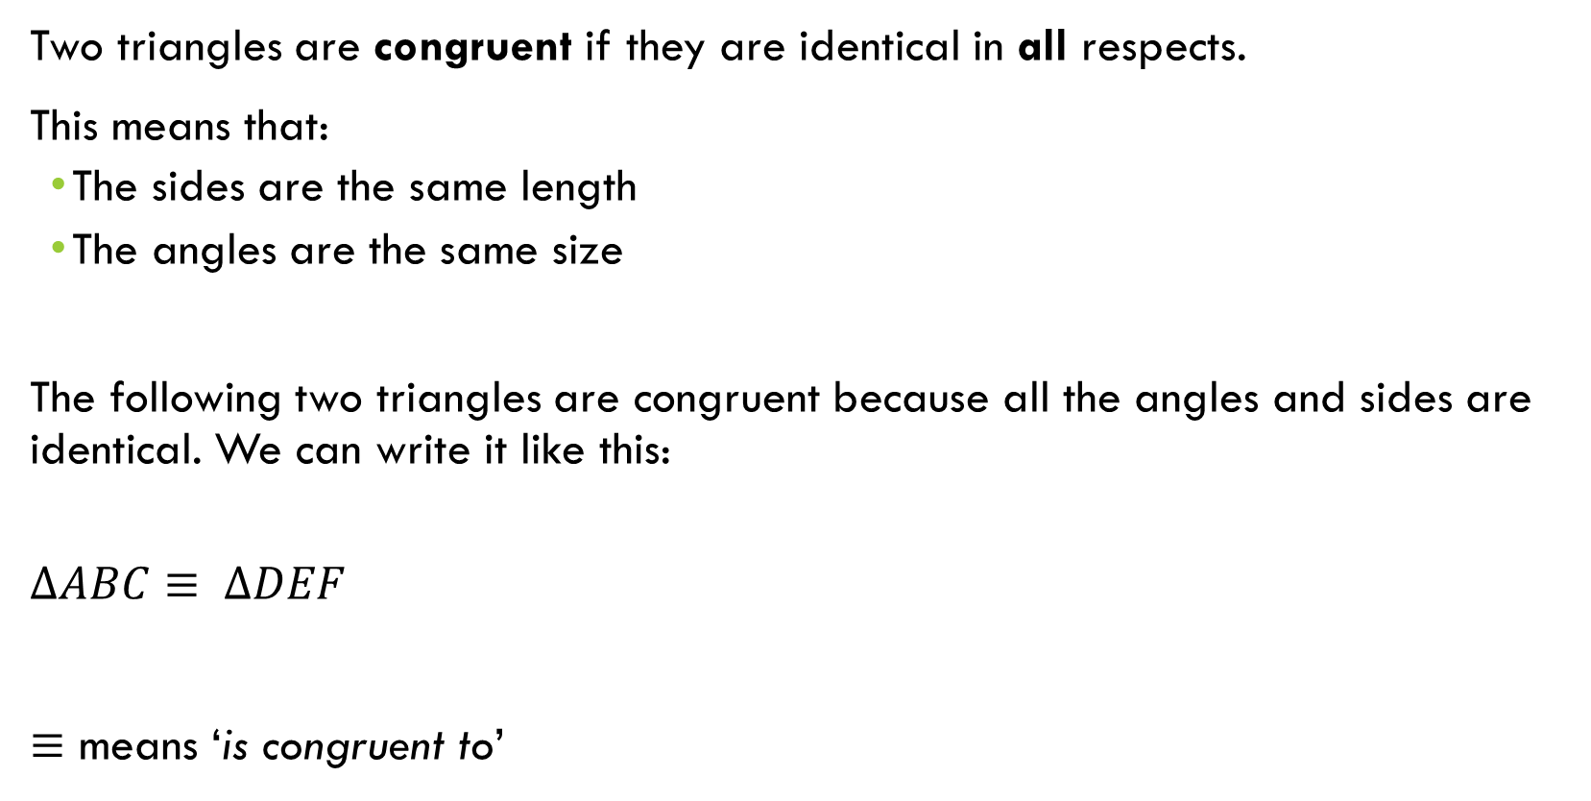
24
7
30
Congruency
Date
EQ – How do we know triangles are the same?
What is congruent?
Two triangles are congruent if they are identical in all respects.
This means that:
The sides are the same length
The angles are the same size
The following two triangles are congruent because all the angles and sides are identical. We can write it like this:
$$∆ABC≡ ∆DEF$$
$≡$ means ‘is congruent to’

Slide 4
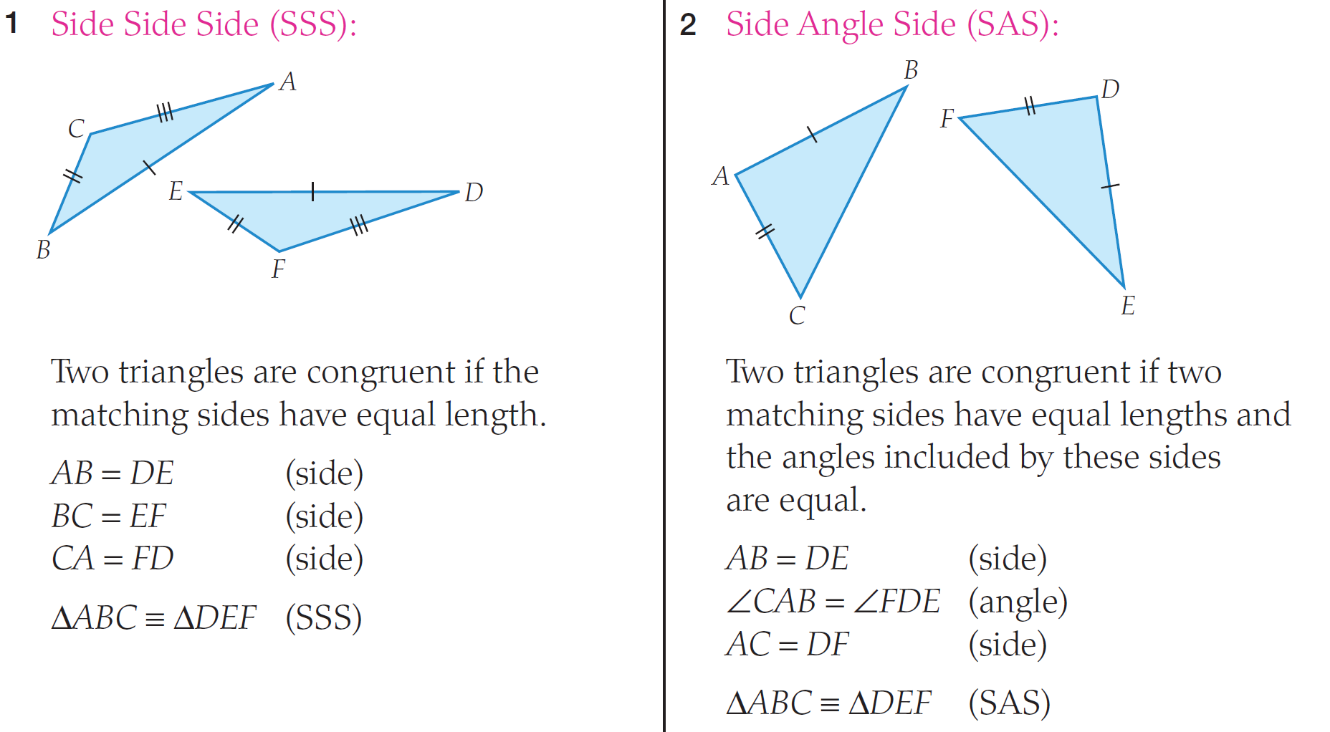
Tests for Congruent Triangles

Slide 5
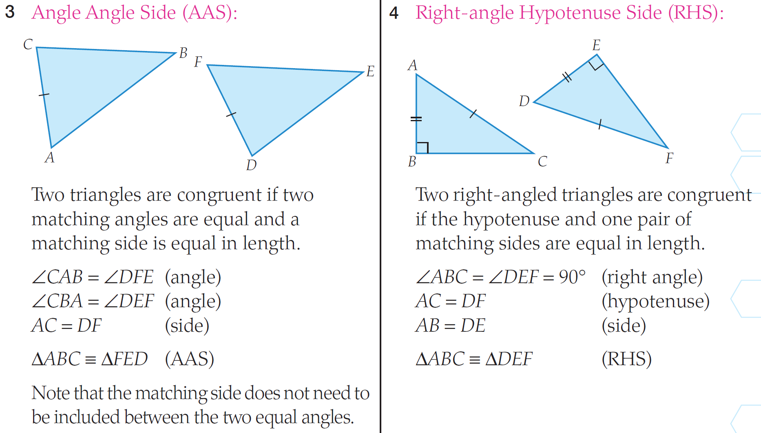
Tests for Congruent Triangles

Slide 6
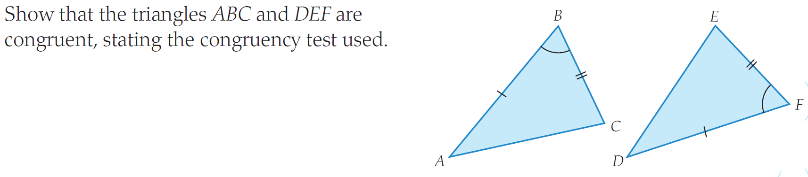
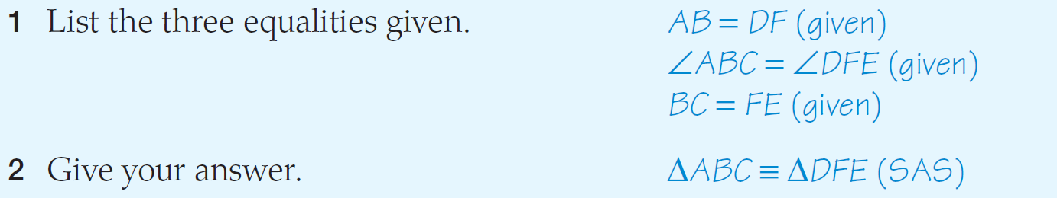
Example 1

Slide 7

Write Your Summary
You have 3 minutes to write a summary that answers the Essential Question.
Be prepared to share your summary with the people sitting in your row.
This Photo by Unknown Author is licensed under CC BY-NC-ND

Slide 8
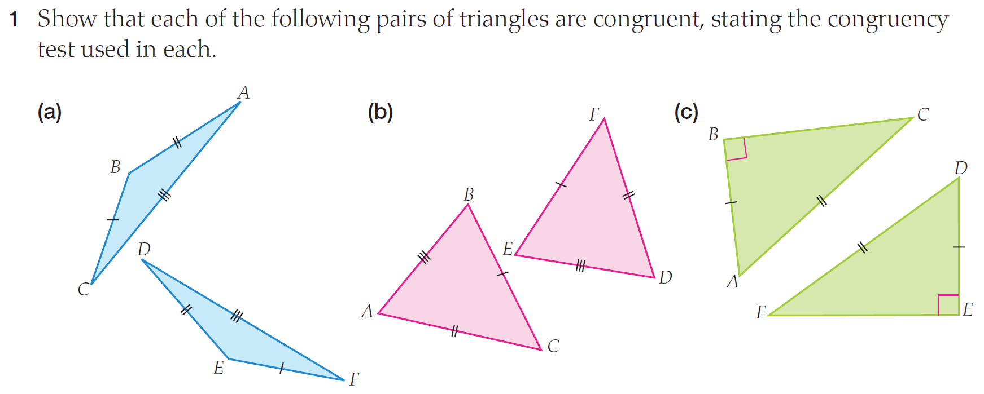

Slide 9
